Slide 1

Payment Processing

Slide 2
Agenda
Payments: why, what?
Payment processor
Payment processor tasks
Rules of implementing payment processor
Asynchronous payment processing

Slide 3
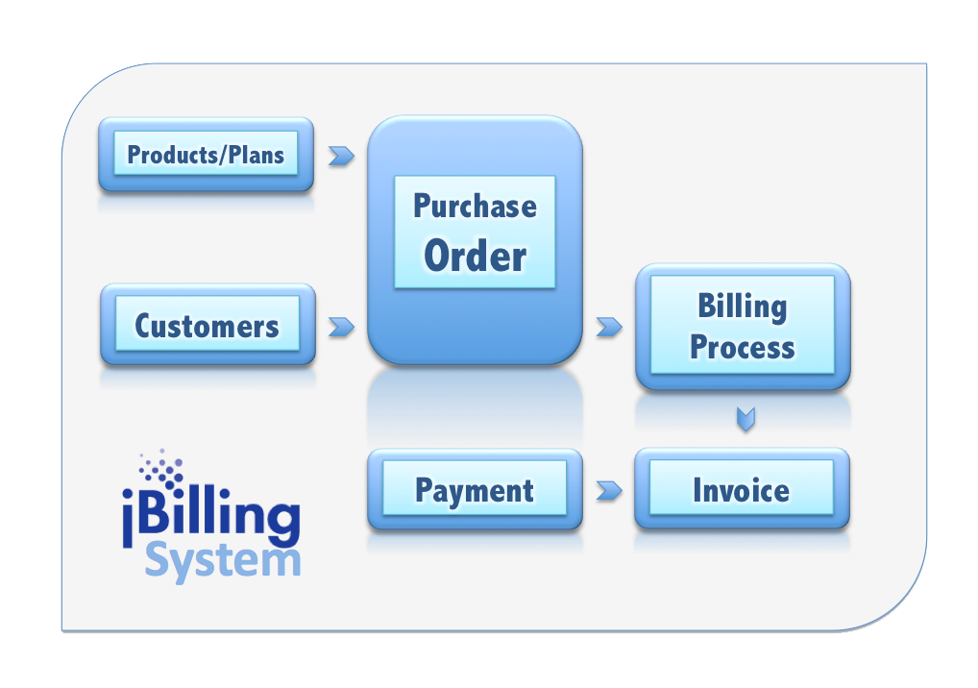
Payments
Payments are the last step of the main billing workflow

Slide 4
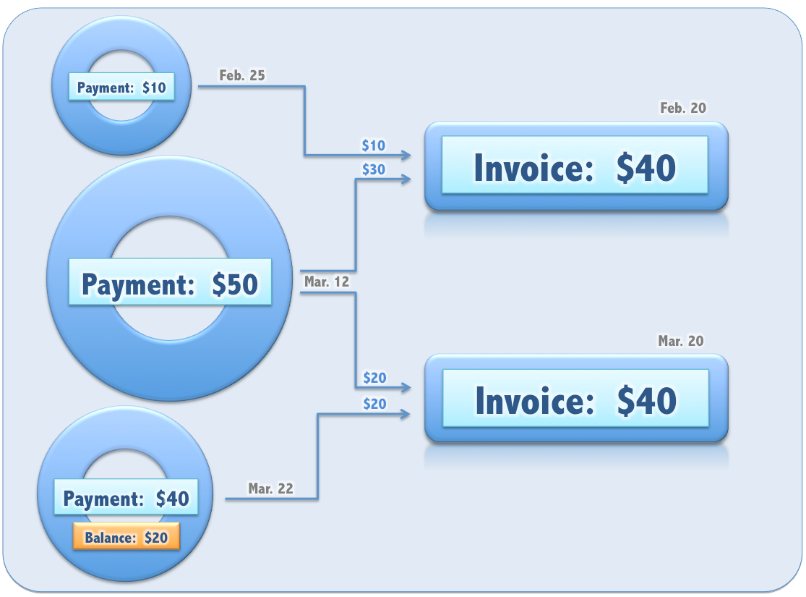
Payments
Payments have a many-to-many relationship with invoices

Slide 5
Payments
jBilling is not standalone billing system
Integrated application with many interfaces
Plug-in architecture
Payment plugins extend the payment interface
Step-by-step instructions on how to create a new payment processing plug-in are in the ‘jBilling Extension Guide’

Slide 6
PaymentsProcessor Requirements
Support many payment options (credit card, ach or direct debit)
Provide fail-over
Support for custom protocols for each gateway
Ease of use/configuration
Abstract classes that provide default implementation

Slide 7
Different Processor Tasks
Payment Task
payment info task
payment router task

Slide 8
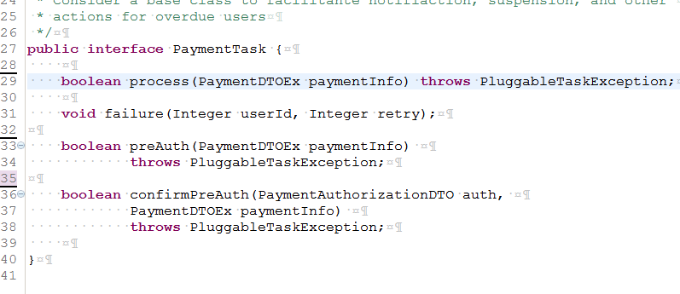
Interface : PaymentTask

Slide 9
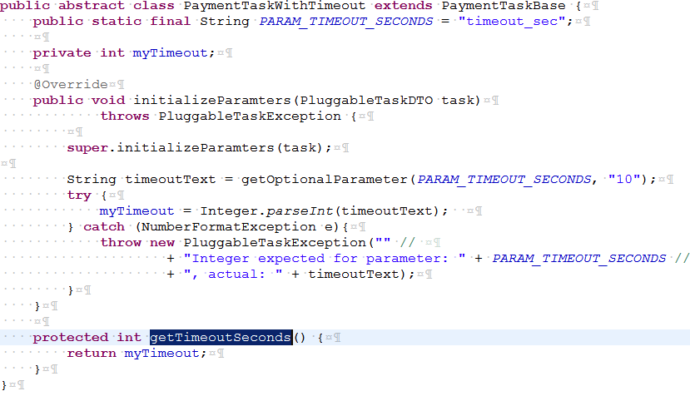
Rules for implementing a payment processor
Rule 1 : Implement a time-out seconds or mili-seconds: For timeout, gateway unavailable

Slide 10
Rules for implementing a payment processor
Rule 2 :
Always Use Parameters for configurable values
For example:
gateway url
Api key
Username
Password
Etc.
This practice helps in easily switching test and production settings.

Slide 11
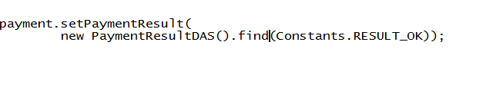
Rules for implementing a payment processor
Rule 3 :
Update the payment object with the result
Constants.ok constants.fail constants.unavailable

Slide 12
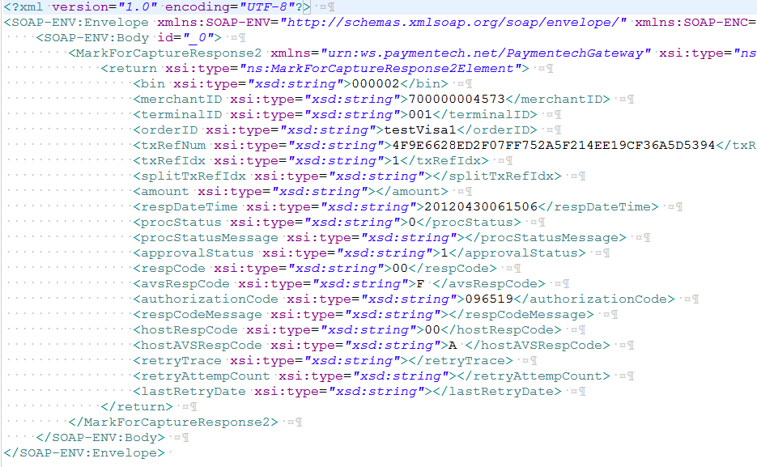
Rules for implementing a payment processor
Rule 4 :
Parse the processor result as paymentauthorizationDto

Slide 13
Rules for implementing a payment processor
Rule 5 :
Return true or false
As a rule, always return false
Return true only if the gateway is unavailable
This gives a chance for the other processors to be called to process the payment

Slide 14
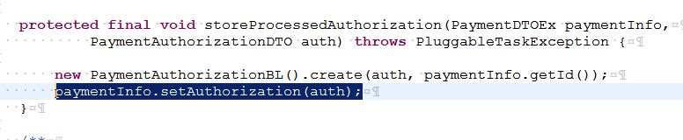
Rules for implementing a payment processor
Rule 6 - 7 :
Add authorization result to the payment
Create the auth record in the database

Slide 15
Payment Instrument
PaymentInfoTask
Is a category of plug-in which is tasked to find Customer’s payment method or instrument (Credit Card, ACH). Typically, find a valid credit card for a user
The return value of this plug-in will be the parameter for the payment processing plug-in (PaymentDTOEx)
public interface PaymentInfoTask {
PaymentDTOEx getPaymentInfo(Integer userId) throws TaskException;
}

Slide 16
Payment Routing
PaymentRouterTask
Not really a PaymentTask payment task
Routes payment processing to the right PaymentTask
public abstract class AbstractPaymentRouterTask
extends PluggableTask implements PaymentTask {
/**
* Determines what processor is to process the payment.
* Takes the payment info and returns a processor.
*/
protected abstract PaymentTask selectDelegate(PaymentDTOEx paymentInfo) throws PluggableTaskException;
}

Slide 17
Asynchronous Payment Processing
The billing process should not ‘wait’ to get a payment processed (ideally, payment processing would be in a different batch)
When the time comes to process a payment, the billing process will post a message in a queue.
Using JMS with ActiveMQ, a message driven class will pick up the request: ProcessPaymentMDB.java
The configuration for JMS is all done with Spring: grails-app/conf/spring/resources.xml

Slide 18
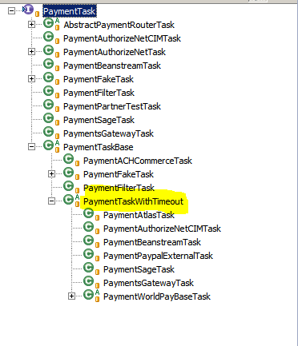
Plugins to integrate

Slide 19
Thanks!!
Notes:
<number>

